Slide 1
InternKaksha
Project1:
Data Visualization of Bird Strikes between 2000 – 2011

Slide 2
Introduction
This project dives into the intricate realm of aviation safety, focusing on bird strikes in the United States from 2000 to 2011. Through four dynamic dashboards, we dissect a dataset of 25,429 incidents, uncovering trends, costs, and crucial insights for proactive safety measures. From temporal trends and altitude analysis to airport and wildlife impact, this visualization journey aims to provide a nuanced understanding of bird strike occurrences, guiding stakeholders in enhancing aviation safety.

Slide 3
Dashboard 1
1) Key Performance Indicators (KPIs):
Cost Incurred: USD 142M
Total Incidents: 25,429
People Injured: 21
2) Top Incidents Analysis:
Top 6 Airports: Column chart depicting the airports with the highest incident counts.
Top 6 Airlines: Column chart showcasing the airlines with the highest incident counts.
3) Aircraft Size Analysis:
Pie chart: Yes or No analysis on whether the aircraft is large.
4) Temporal Trends:
Line chart: Count of incidents over the years.

Slide 4
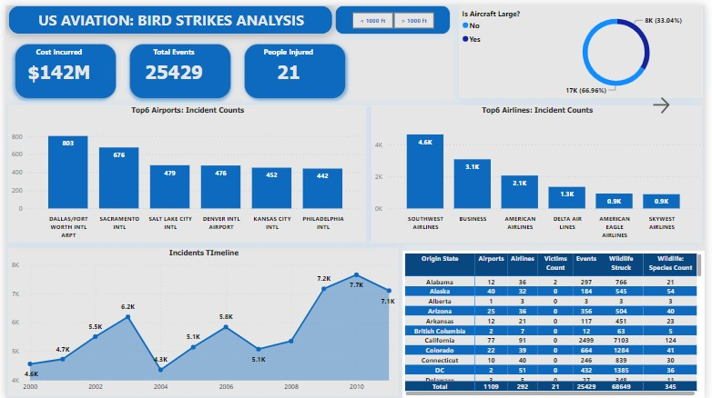

Slide 5
Dashboard 2
1) Altitude and Warning Analysis:
Pie charts: Altitude Bin: <1000 fts and >1000 fts
Pilot Warned: Yes or No
Impact to Flight
2) Incident Details:
Bar chart: Top 6 Aircraft Models: Incident counts by aircraft models.
Wildlife Species Struck Count.
3) Cost Analysis:
Area chart: Year-wise cost incurred.

Slide 6
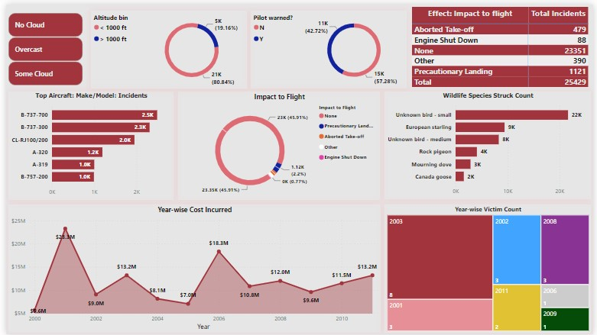

Slide 7
Dashboard 3
1) Key Performance Indicators (KPIs):
Number of Airports: 1,109
Number of Airlines: 292
Count of Aircraft Models: 324
2) Incident Analysis:
Column chart: Top 10 Aircraft Models by incident counts.
Pie charts:
Incidents with regards to Sky (Cloud) Conditions.
Incidents with regards to Flight Phase.

Slide 8
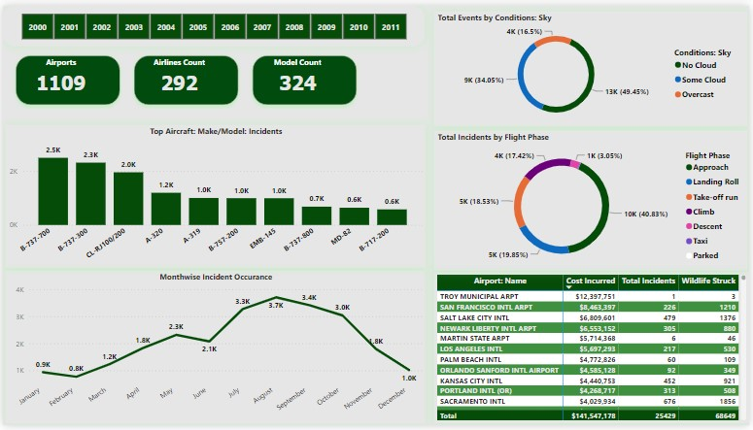

Slide 9
Dashboard 4
1) Key Performance Indicators (KPIs):
Total Remarks Received: 20,668
Wildlife Species Types: 345
Number of States: 61
2) Incident Details:
Column chart: Incidents with regards to Conditions of Precipitations.
Top 10 States by incident count.
Collision Height: Feet above Ground.
3) Wildlife Collection Analysis:
Pie chart: Yes or No analysis on whether the remains of wildlife were collected.
4) Geographic Impact:
Map: Areas affected by bird strikes.

Slide 10
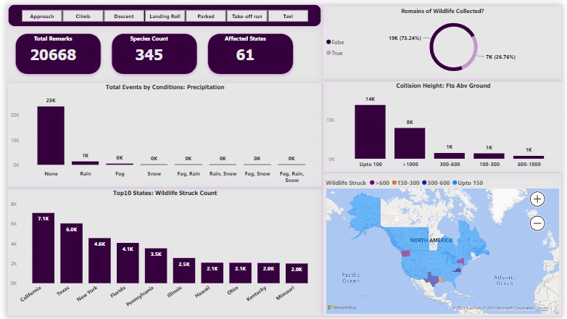

Slide 11
Conclusion
This comprehensive visualization project provides a deep understanding of bird strike incidents from 2000 to 2011. The dashboards highlight key metrics, temporal trends, incident details, and geographic impact, enabling effective analysis and decision-making for aviation safety measures.

